Slide 1
15th Workshop “Software Engineering Education and Reverse Engineering”
Bohinj, 24 - 29 August 2015.
Automatic generation of conceptual
database model based on collaborative BPMN
G. Banjac, D. Brdjanin, S. Maric
University of Banja Luka, Bosnia & Herzegovina

Slide 2
Introduction
Part of over a decade of research of aproaches in model-driven automatic generation of initial conceptual database model
The source model (BPM) is a collaborative business process model represented by BPMN
Target model (CDM) is represented by a UML class diagram
Application of the implemented ATL-based generator is illustrated on two business process models

Slide 3
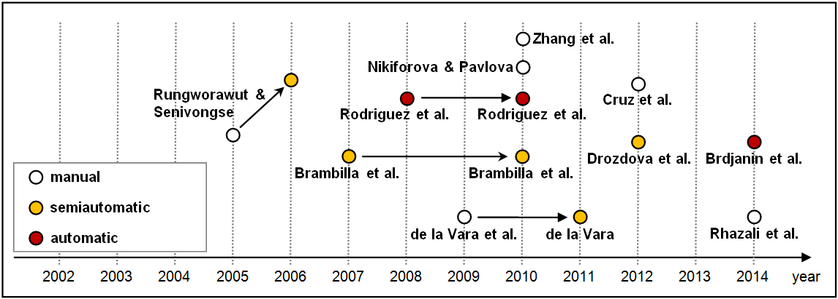
Related work
BPMN-based approaches to data model synthesis
The semantic capacity of BPM has not yet been sufficiently identified to enable the automatic synthesis of the complete CDM, since the existing approaches still do not have significant precision and recall in the automated generation of some types of associations and class members

Slide 4
Source model (1/4)
BPMN (Bussiness Process Model and Notation) is a graphical notation for modeling business processes
Based on other BPM notations such as UML activity diagram, EPC, etc.
Three types of BPMN models:
Process (orchestration)
Choreography
Collaboration
History of BPMN
2004.
2006.
2008.
2009.
2011.
2013.
BPMI released BPMN 1.0
BPMN adopted as OMG standard
BPMN 1.1 released
BPMN 1.2 released
BPMN 2.0 released
(BPMN 2.0 has a formal definition in a form of metamodel)
BPMN 2.0.2 released
(OMG/ISO 19510:2013)

Slide 5
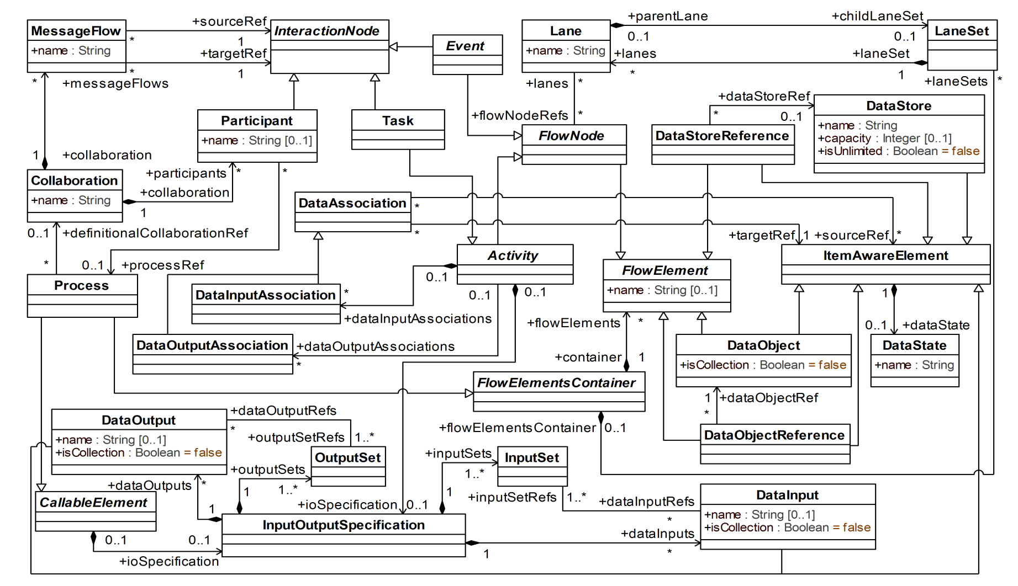
Source model (2/4)
BPMN metamodel excerpt for collaborative BPM representation

Slide 6
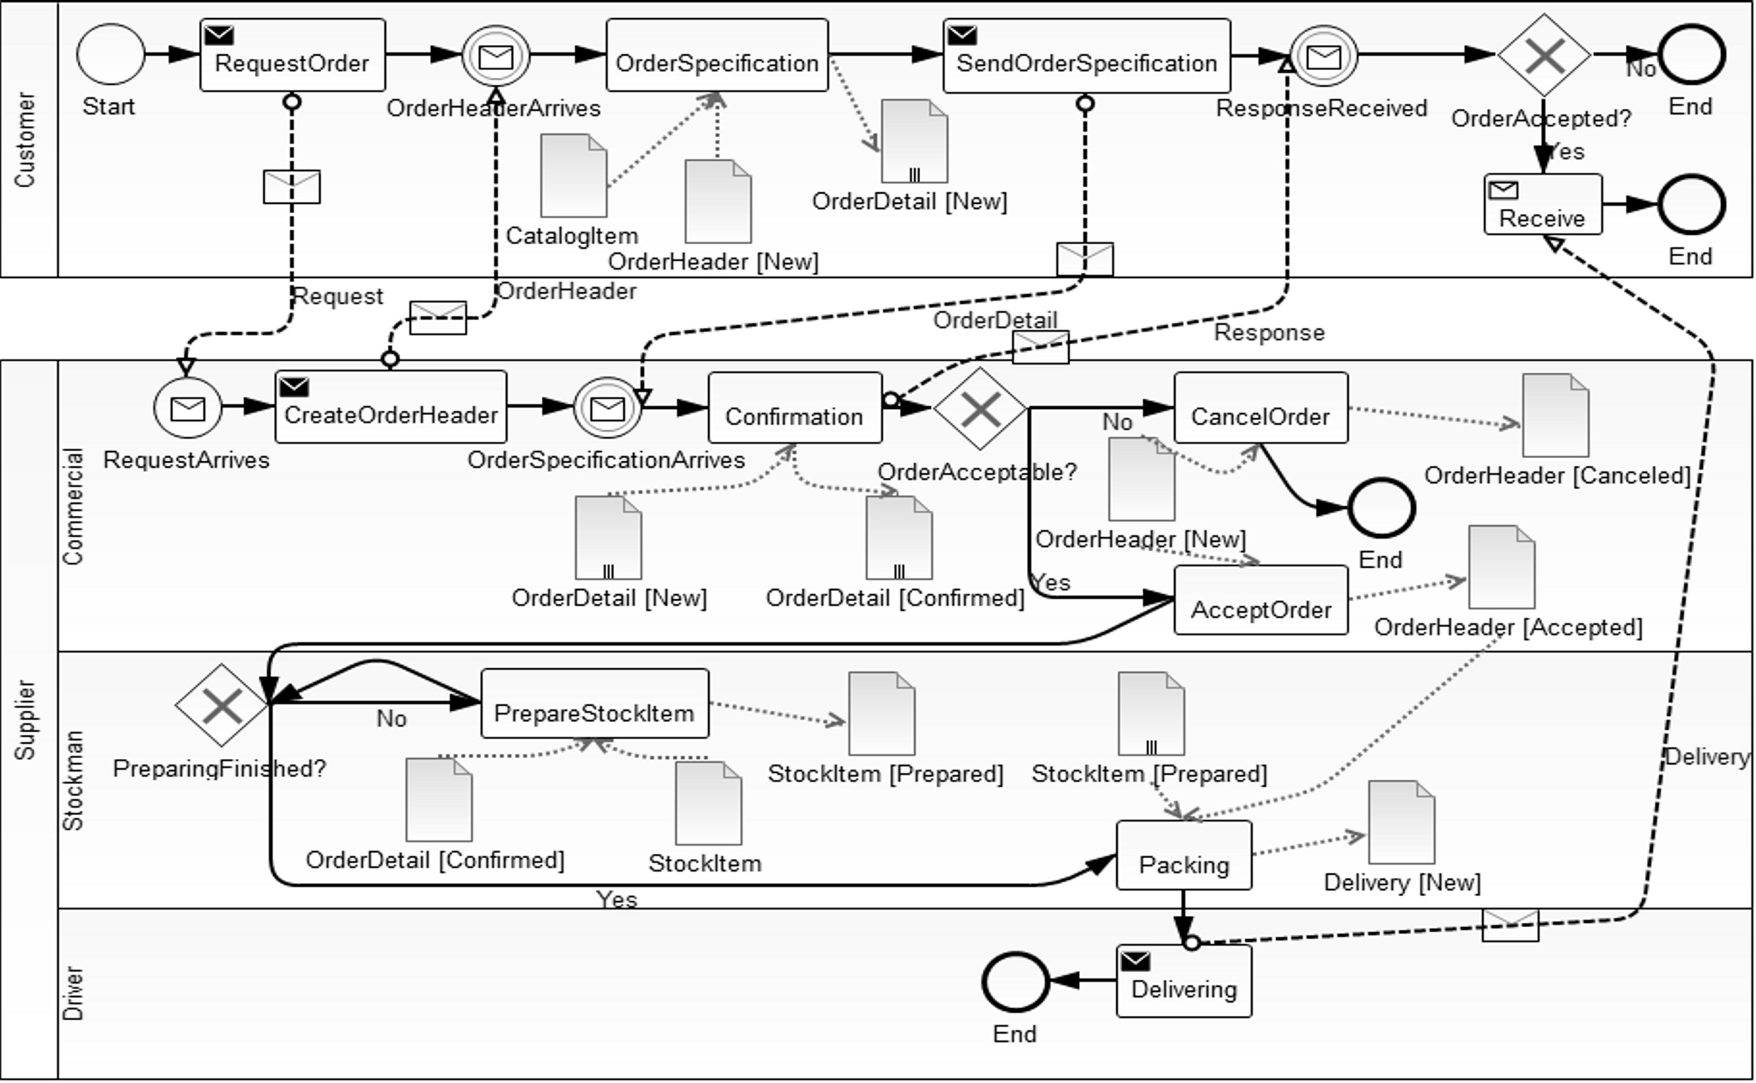
Source model (3/4)
Sample collaborative BPM – Order processing

Slide 7
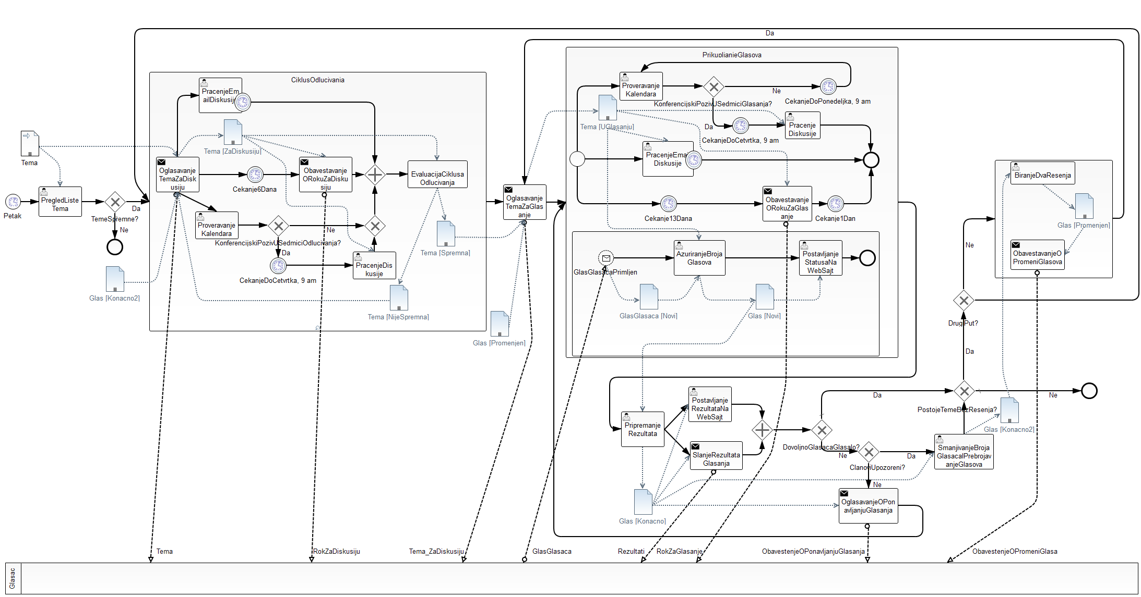
Source model (4/4)
Sample collaborative BPM – E-mail voting (OMG)

Slide 8
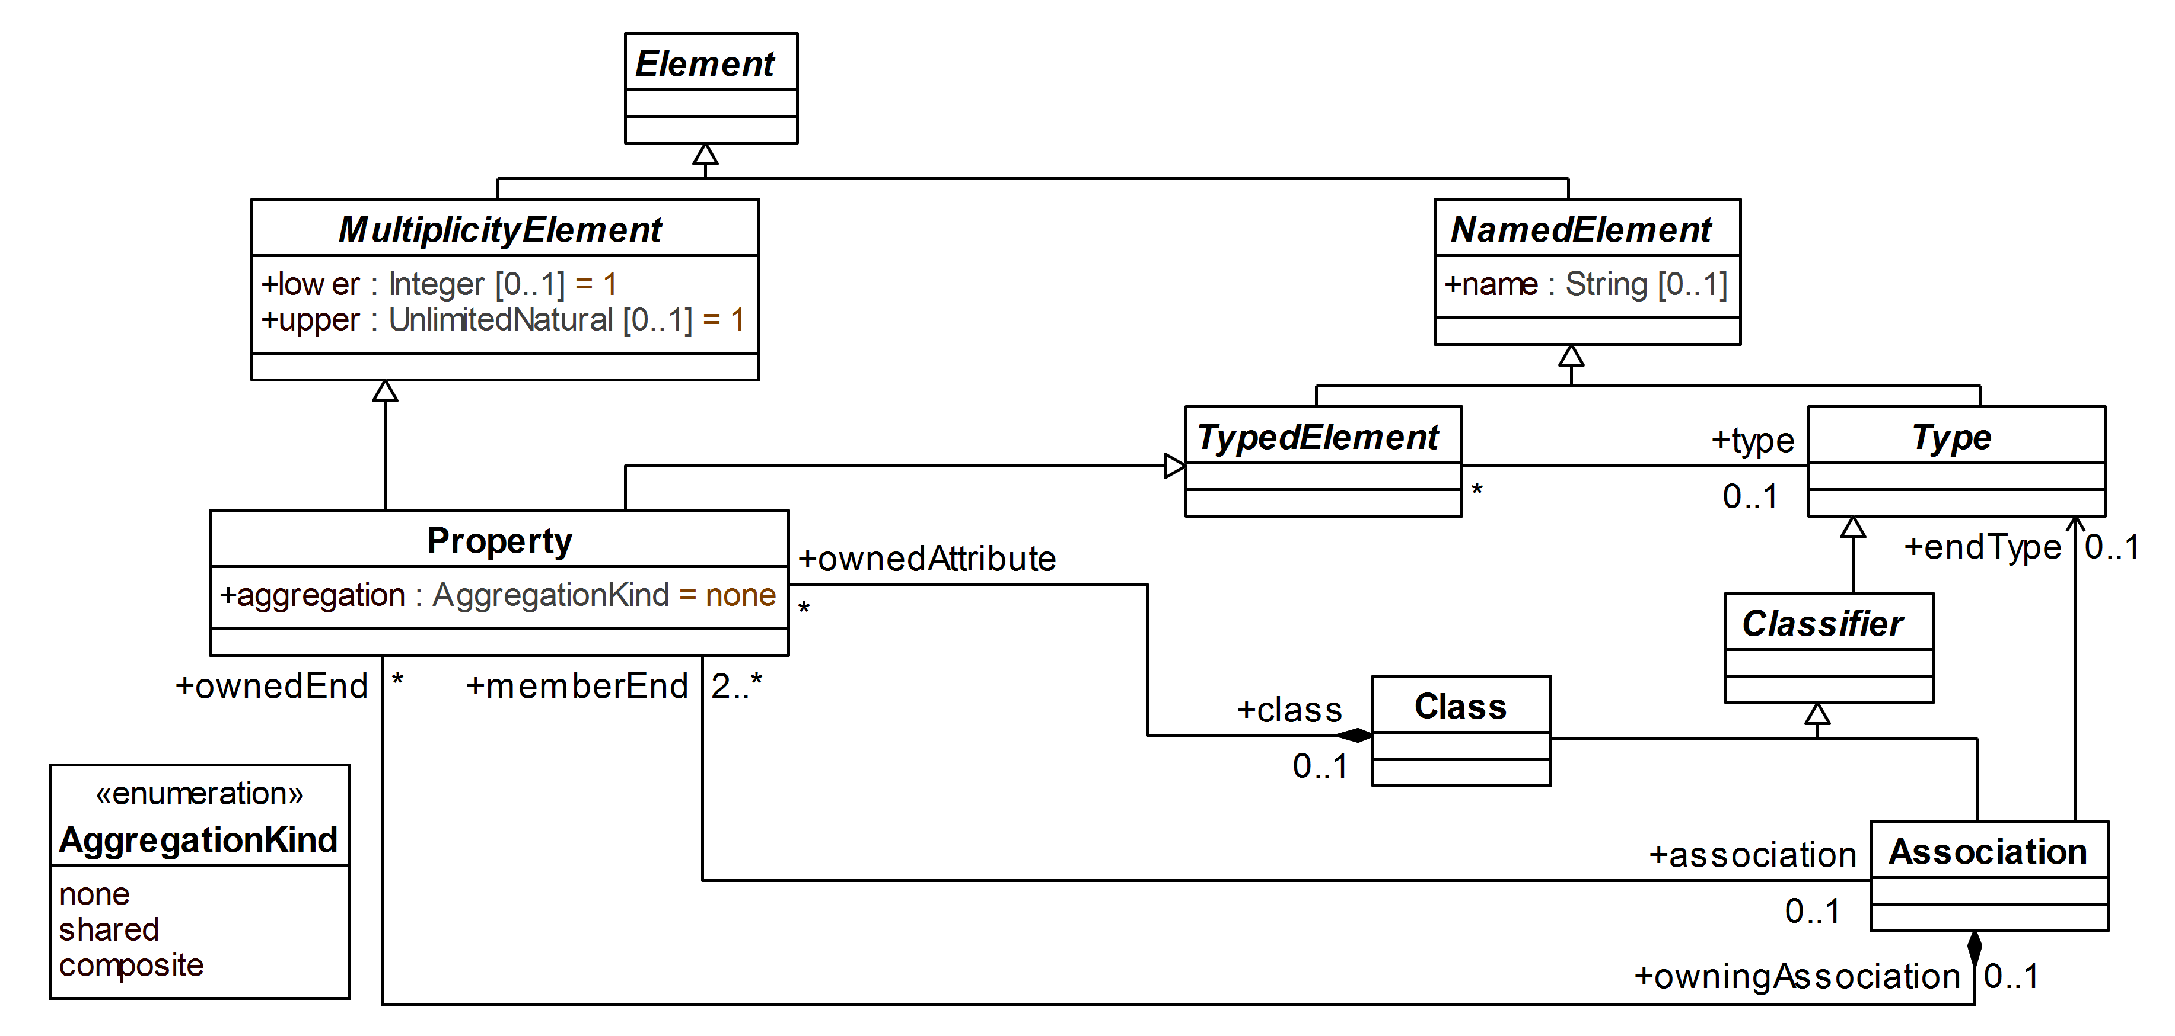
Target model
UML metamodel excerpt for CDM representation

Slide 9
Synthesis of CDM based on collaborative BPM
There are three bases for automated generation of classes:
Participants
Objects
Activations of existing objects
There are three kinds of class associations:
Participant-participant associations
Participant-object associations
Creation and subsequent usage of generated objects
Exchange of messages
Activation and subsequent usage of activated objects
Object-object associations
Activation of existing objects
Actions having input and output objects

Slide 10
Automated generation of classes
Participants
Objects
P
P
P1
P1
P2
L2
T1
O
T2
P_L1
L1
P_L2
MF
P2
O
MF
Activations of existing objects
P
P
O
O
T1
[state]
O_state
O

Slide 11
Automated generation of associations (1/3)
Participant-participant associations
P
P
1
*
P_L1
L2
P_P_L1
1
L1
P_P_L2
*
P_L2

Slide 12
Automated generation of associations (2/3)
Participant-object associations
Creation and subsequent usage of generated objects
Exchange of messages
P
P1
P
P1
1
1
P1_MF1
1
1
P1_MF2
O
T1
T2
*
*
T1
T2
*
*
MF1
MF1
MF2
O
MF2
P2
P2_MF1
*
*
P2_MF2
1
1
P2
Activation and subsequent usage of activated objects
P
P
O
O
1
T1
1
T2
T1
[state]
T2
*
*
O_state
O

Slide 13
Automated generation of associations (3/3)
Object-object associations
Activation of existing objects
P
P
O
O
1
T1
1
T2
T1
[state]
T2
*
*
1
O_state
*
O
T1
Tasks having input and output objects
Non-activated existing input obj.
T
O1
1
*
O2
O1
O2
T
T
O1
*
*
O2
O1
O2
T
Generated input objects / Activated existing input objects
T
O1
1
1
O2
O1
O2
T
T
O1
1
*
O2
O1
O2
T
T
O1
*
1
O2
O1
O2
T
T
O1
*
*
O2
O1
O2
T

Slide 14
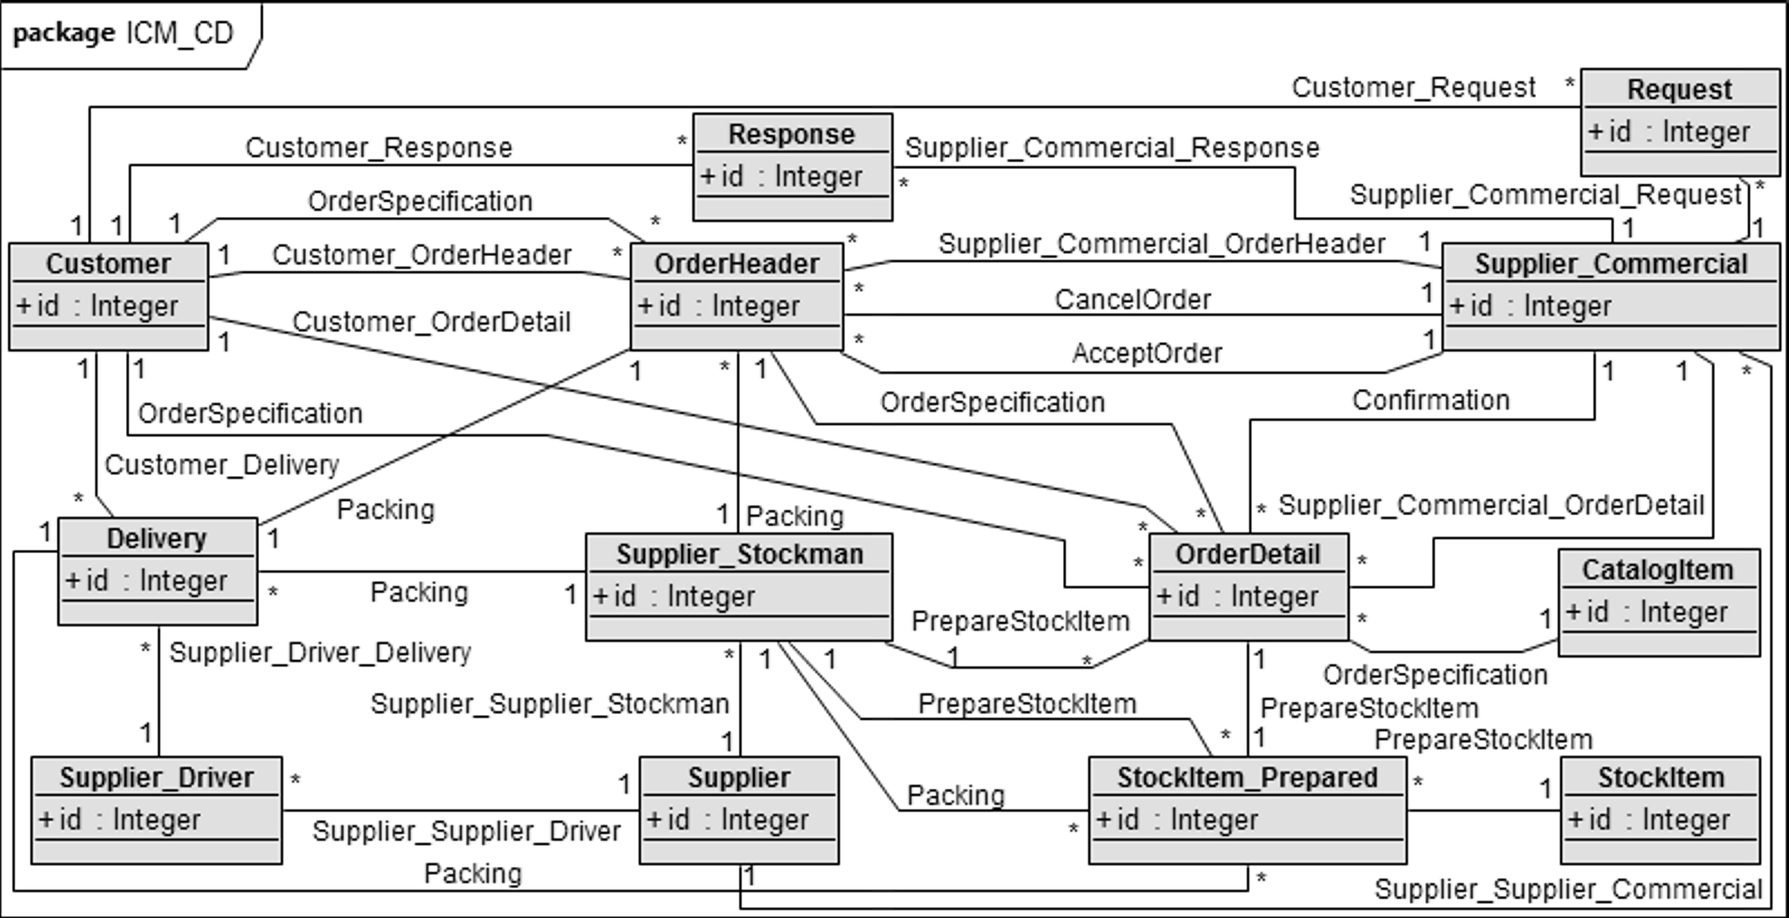
Experimental results (1/2)
Concepts | Metrics & Measures
 | N_{generated} | N_{correct} | N_{incorrect} | N_{sur plus} | N_{sur minus} | Recall [%] | Precision [%]
Classes | 13 | 13 | 0 | 0 | 0 | 100 | 100
Associations | 29 | 28 | 1 | 3 | 1 | 97 | 97

Slide 15
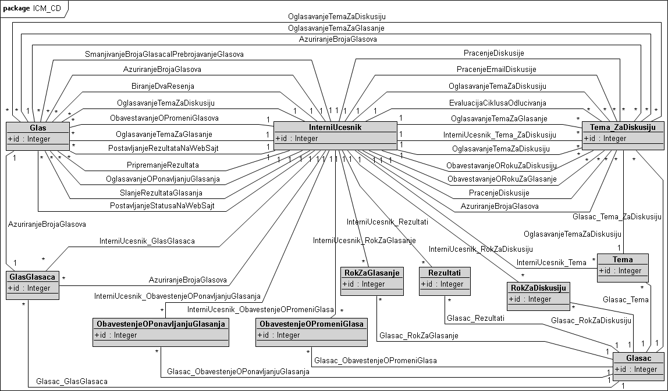
Experimental results (2/2)
Concepts | Metrics & Measures
 | N_{generated} | N_{correct} | N_{incorrect} | N_{sur plus} | N_{sur minus} | Recall [%] | Precision [%]
Classes | 11 | 11 | 0 | 0 | 0 | 100 | 100
Associations | 43 | 37 | 6 | 2 | 1 | 97 | 86

Slide 16
Conclusion
Initial evaluation of the automatically generated CDM implied that the generator is able to generate a very high percentage of the target CDM with a very high precision
After initial evaluation, we have conducted more extensive evaluation of the approach, with more models / designers, which confirmed findings from the initial evaluation
Even more extensive evaluation of the approach will be part of future work, as well as further identification of the semantic capacity of BPM for automated CDM design

Slide 17
15th Workshop “Software Engineering Education and Reverse Engineering”
Bohinj, 24 - 29 August 2015.
G. Banjac, D. Brdjanin, S. Maric
University of Banja Luka, Bosnia & Herzegovina
Automatic generation of conceptual
database model based on collaborative BPMN
Thank You!

